Slide 1
Nuvoton Android ISP
Notes:
115/11/07

Slide 2

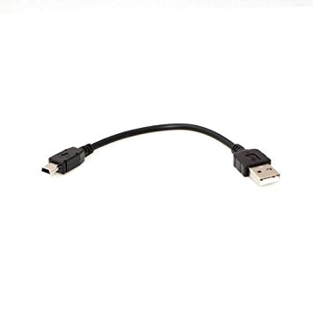
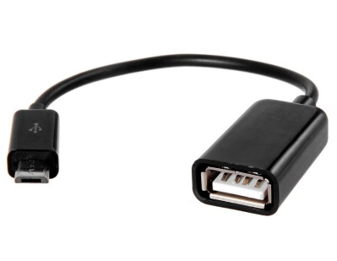
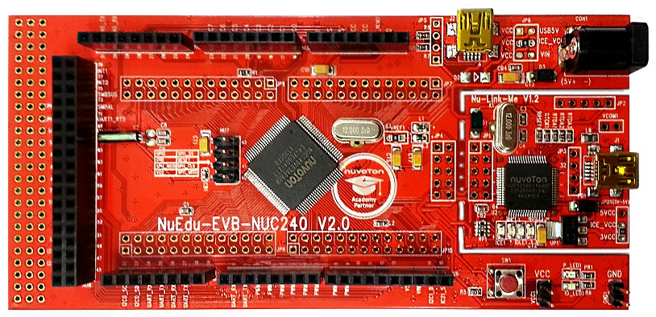
Hardware Setting
Mini USB cable
OTG cable
Android phone
PC
(debug/download code)
NUC240 Nuedu board(PA1 to GND for ISP mode)

Slide 3
Android Phone Requirement
Need Support USB OTG
After Android 5.0 Version

Slide 4
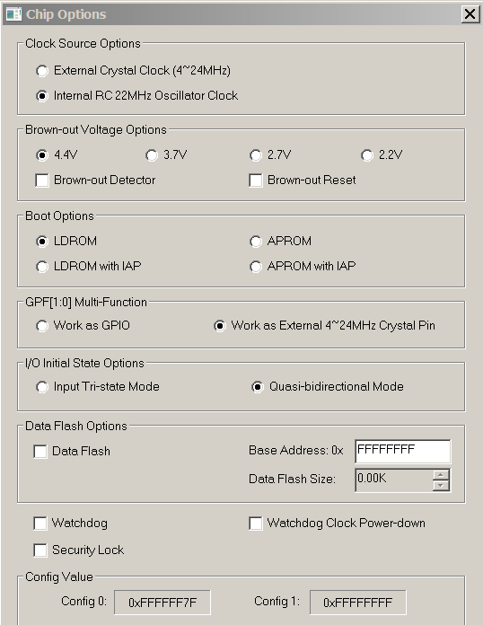
Nuedu NUC240 FW
Config must setting boot in LDROM
LDROM project path:
\NUC230_240 VID1234 PID5678
\SampleCode\StdDriver\ISP_HID\KEIL
Reset and boot in LDROM,
The android APP will auto run.

Slide 5
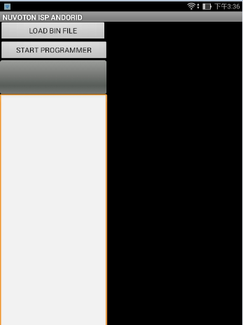
NUVOTON ISP Quickly Guide
Select “LOAD BIN FILE”

Slide 6
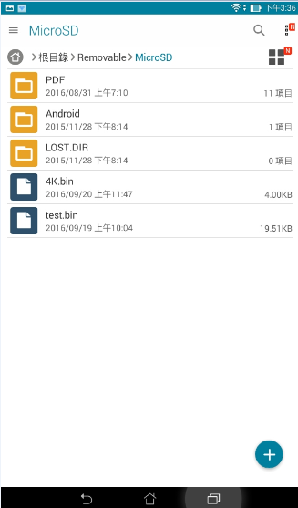
NUVOTON ISP Quickly Guide
Select Target BIN file in Phone

Slide 7
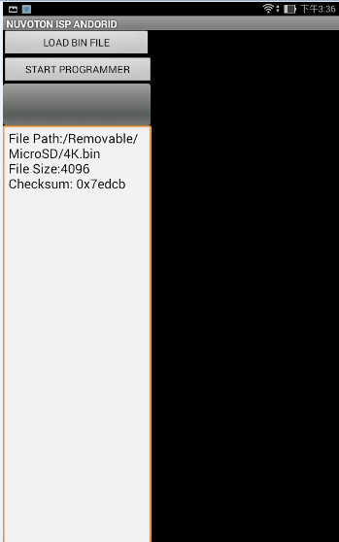
NUVOTON ISP Quickly Guide
After select file,
The APP will to show
1, File Path
2, File Size
3, File Checksum

Slide 8
NUVOTON ISP Quickly Guide
Select “START PROGRAMMER”

Slide 9
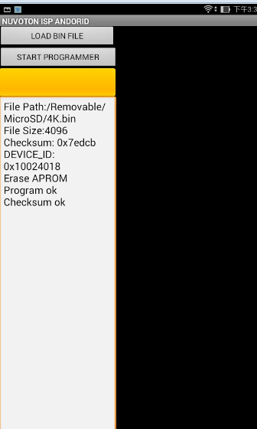
NUVOTON ISP Quickly Guide
The programmer progress
Chip ID
Erase / programmer / checksum message

